Slide 1
School Práxis Flamboyant
Teacher: Julia Ortiz
5th Grade:
Horror time!
Test review.

Slide 2
Matéria da prova!
Unit 2: Lesson 3 “Holidays and festivals”, identificar as celebrações em inglês, seus símbolos, tradições e identificar o mês em que cada uma é comemorada.
Lesson 4 “Seasons of the year”, identificar, nomear e descrever as características das 4 estações do ano, além da roupa adequada para cada estação. Saber a diferenciação entre “WHY” e “BECAUSE, colocando-os corretamente em uma frase.
Páginas: 45 a 67.

Slide 3
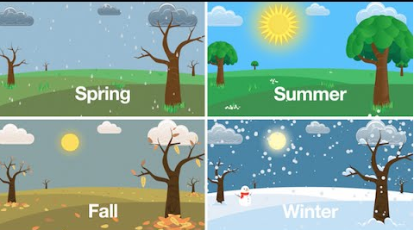
Seasons of the year:

Slide 4
What are their characteristics?
Winter: cold and snowy!
Spring: rainy and the flowers bloom!
Summer: hot and sunny!
Fall: dry and leaves change colors and fall!

Slide 5
“Why” and “Because”
Teacher Julia: Hey Lollypop! Wich season of the year do you like best?
Lollypop: I like summer.
Teacher Julia: Why?
Lollypop: BECAUSE I like to go to the swimming pool and wear my swimming suit!
Teacher Julia: ??????

Slide 6
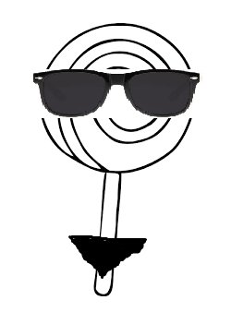

Slide 7
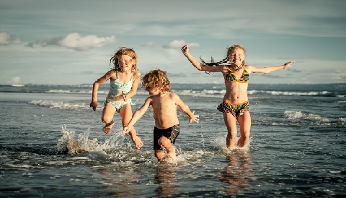
Clothes and the Seasons
SUMMER:
Swimming suit:

Slide 8
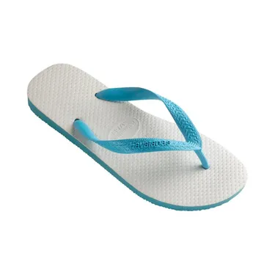
Summer
Sandal:

Slide 9
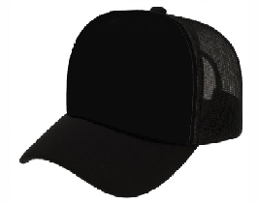
Summer:
Cap:

Slide 10
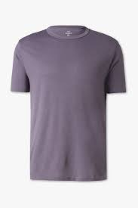
Summer / Fall
T- Shirt:

Slide 11
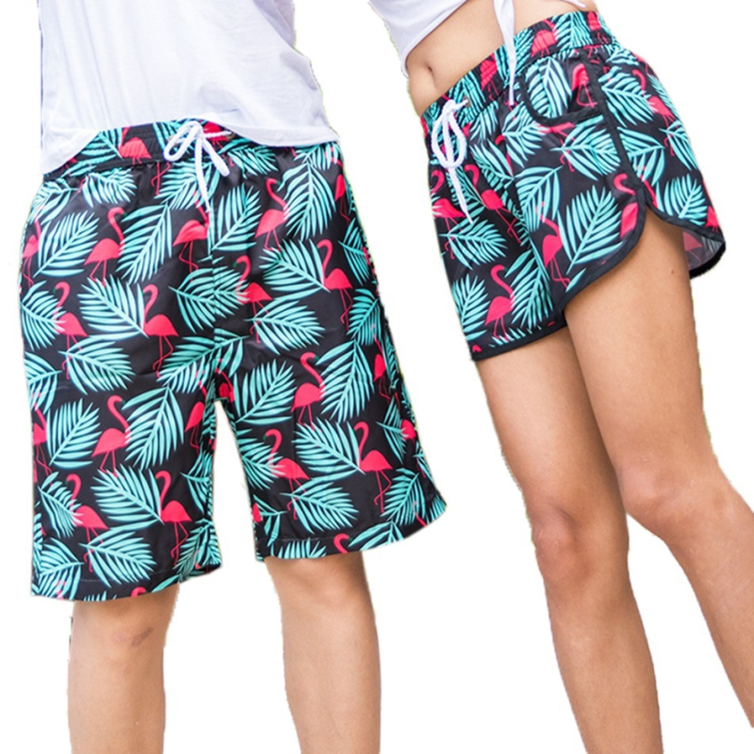
Summer
Shorts:

Slide 12

Summer
Glasses:

Slide 13
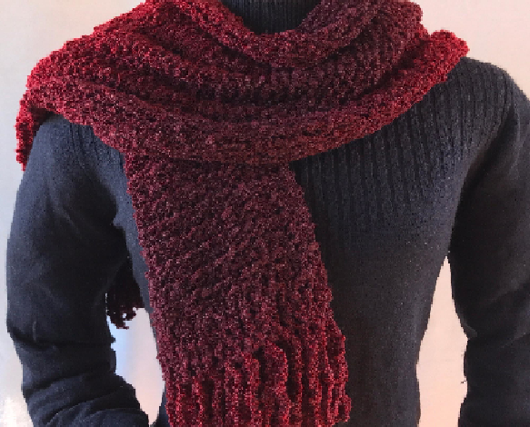
Winter / Fall
Scarf:

Slide 14
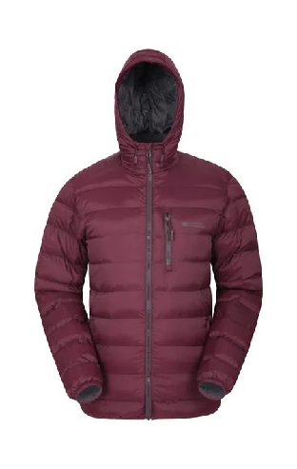
Winter / Fall
Jacket:

Slide 15
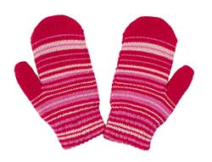
Winter / Fall
Mittens:

Slide 16
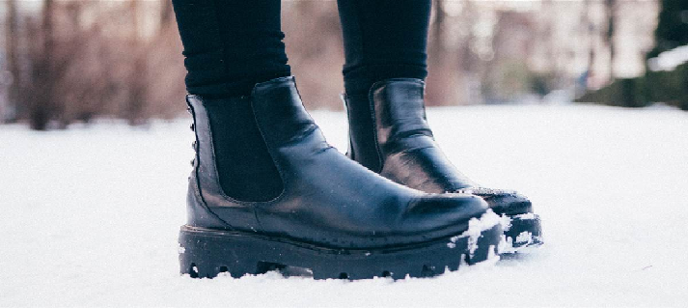
Winter
Boots:

Slide 17
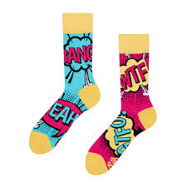
Winter
Socks:

Slide 18
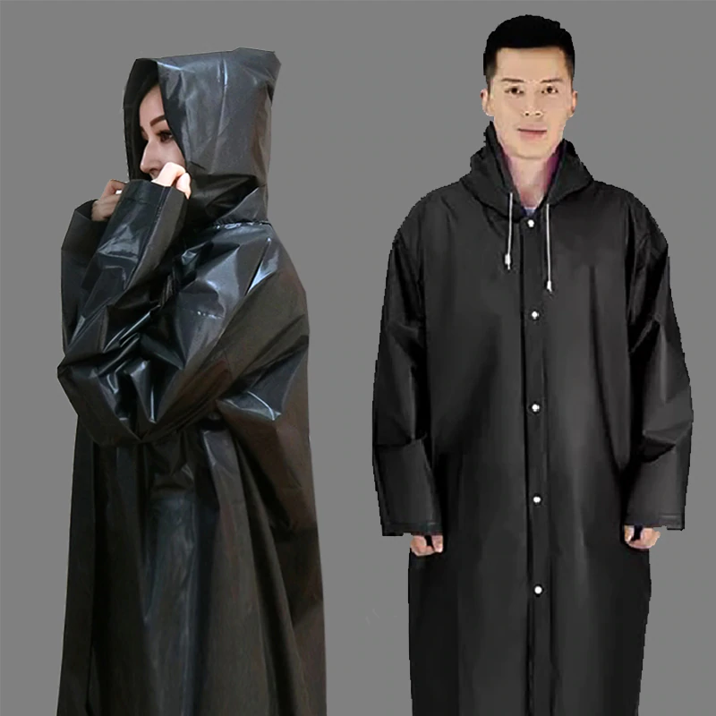
Spring:
Rain coat:

Slide 19
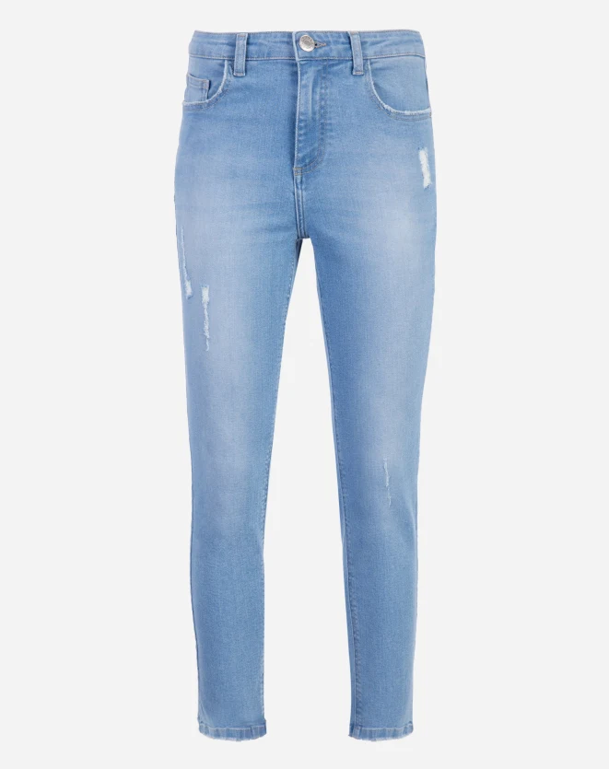
Fall / Spring / Winter
Jeans:

Slide 20
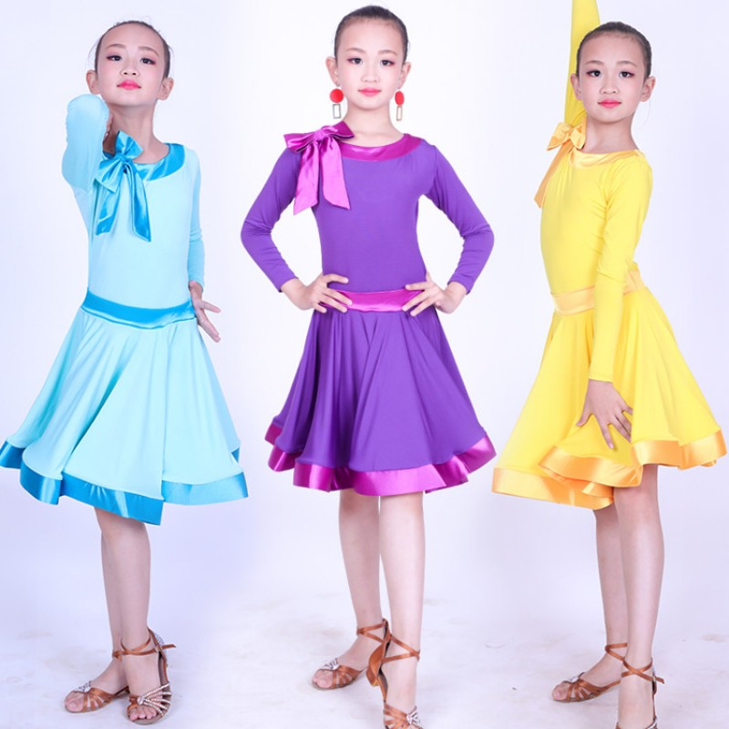
Fall / Spring / Summer
Dress:

Slide 21
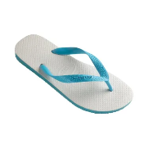

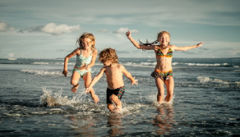



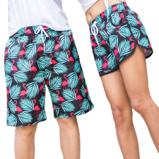

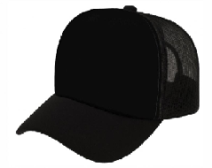
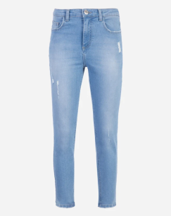

Seasons of the year:

Slide 22
Celebrations
January: New Year’s.
February: Carnaval.
March: the begging of Easter Day.
April: Easter Day.
May: Mother’s Day.
June: Valentine’s Day.
July: Winter vacation.
September: Independence Day.
October: Children’s Day.
November: Thanksgiving Day.
December: Christmas.

Slide 23
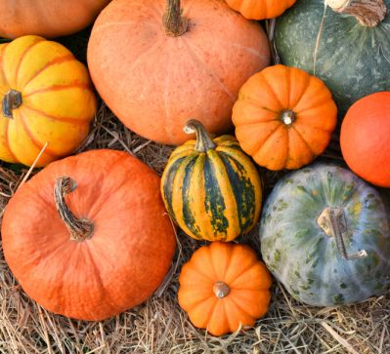
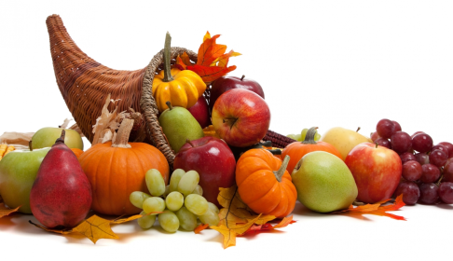
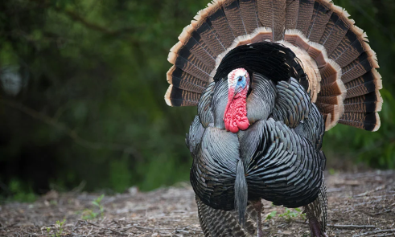
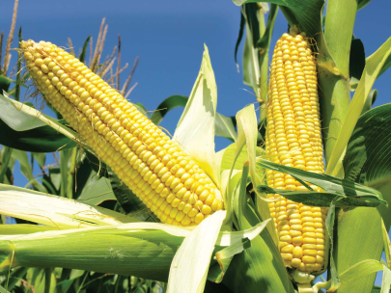
Symbols
Pumpkin
THANKSGIVING
DAY!
Cornucopia
Turkey
Corn

Slide 24
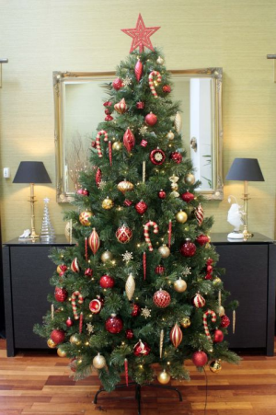
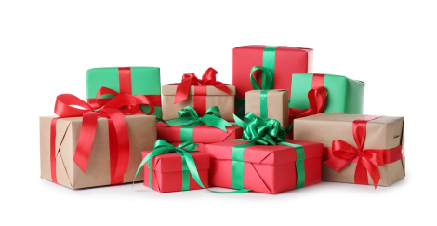
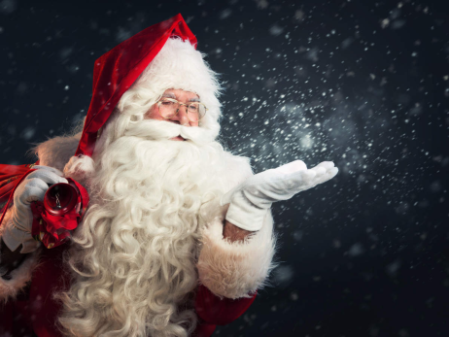
Symbols
Christmas tree
Christmas!
Gifts
Santa Claus

Slide 25
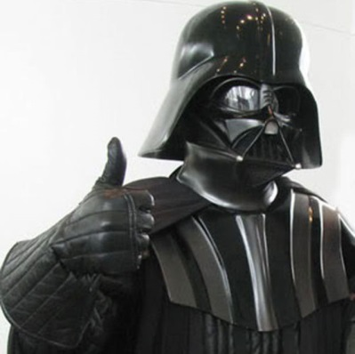
That’s all for today!
Homework:
Study for the test!!

